Slide 1
Queens, New York: Where to Build New Vegetarian and Vegan Restaurants
An analysis of areas in Queens, New York for Your New Vegetarian and Vegan Dining using Foursquare Data

Slide 2
Introduction
Businesses looking to expand quality healthy foods not featuring animal products have much opportunity to establish themselves across Queens, New York.
According to Yelp.com reviews, quality vegetarian and vegan restaurants and dining venues would apparently be appreciated by local residents. More options will increase convenience for residents in particular neighborhoods by reducing travel and wait times for orders.
Those looking for a variety of unique and bold flavors in vegetarian and vegan options may be pleased with a new dining option.
There are 5 boroughs and 306 neighborhoods in New York City. One of the boroughs is Queens, New York.

Slide 3
Data / Library Sources
Foursquare data was generated to explore the most popular venues to locate vegetarian and vegan restaurants to determine the best neighborhoods for additional sites of vegetarian and vegan restaurants.
Libraries used for analysis
numpy
Folium
pandas
json
matplotlib
sklearn

Slide 4
Clustering of Neighborhoods
Neighborhood Groups for Building Your New Restaurant as 3 Possible Options
Out of 81 neighborhoods in Queens, New York, there are three clusters of neighborhoods where a new restaurant could be built.

Slide 5
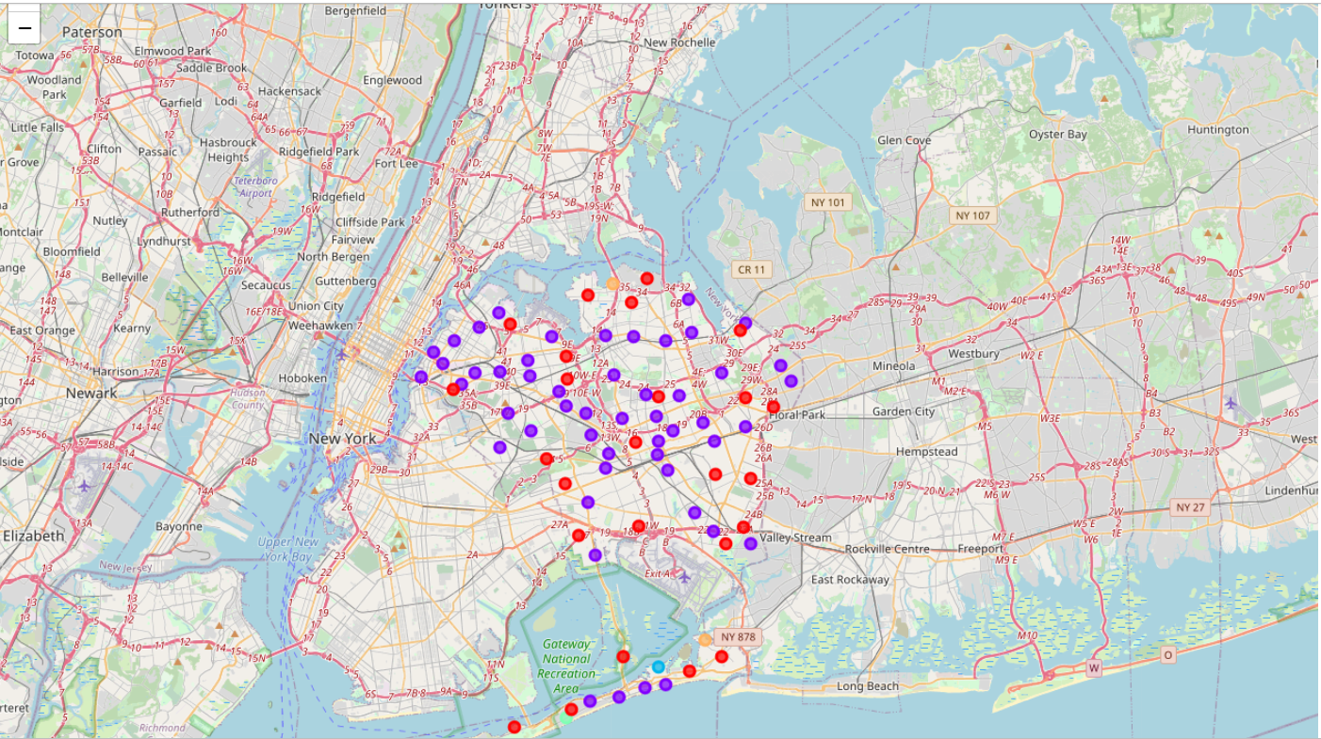
A Visual Look at the possible Hot Spots of Queens, New York for the New Restaurant Using Folium Mapping

Slide 6
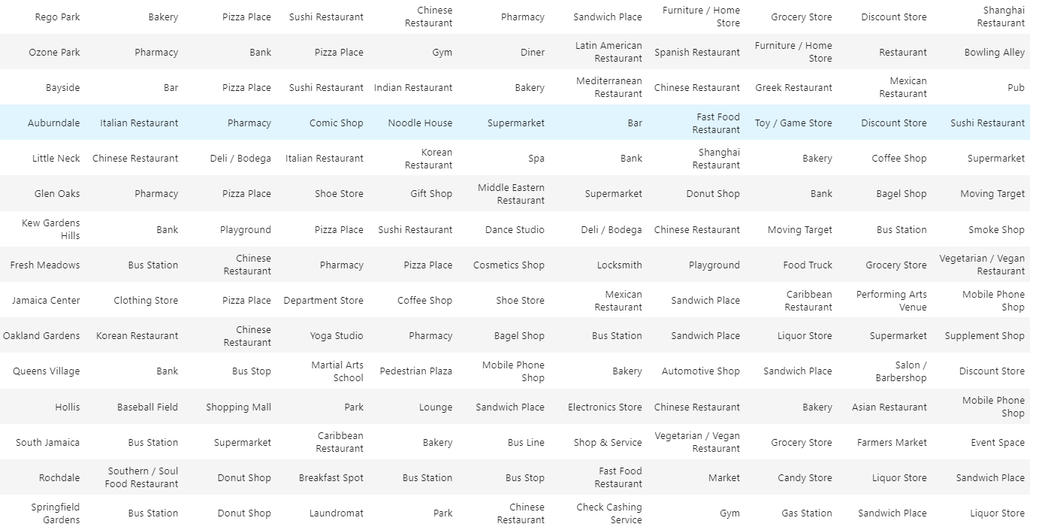
Option 1
Below are 5 neighborhoods that may support another vegetarian and vegan restaurant as it is listed as a 7th and 10th most common venue in two neighborhoods.

Slide 7
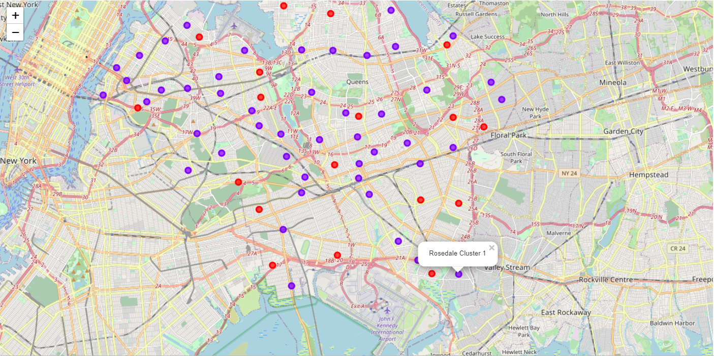
Option 1 Area

Slide 8
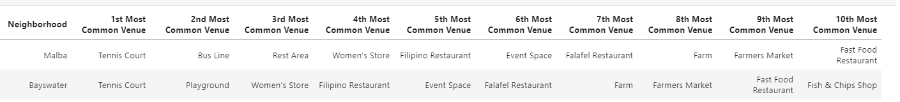
Option 2
Malba and Bayswater areas have established restaurants and area attractions and may be interest in a vegetarian and vegan restaurant.

Slide 9
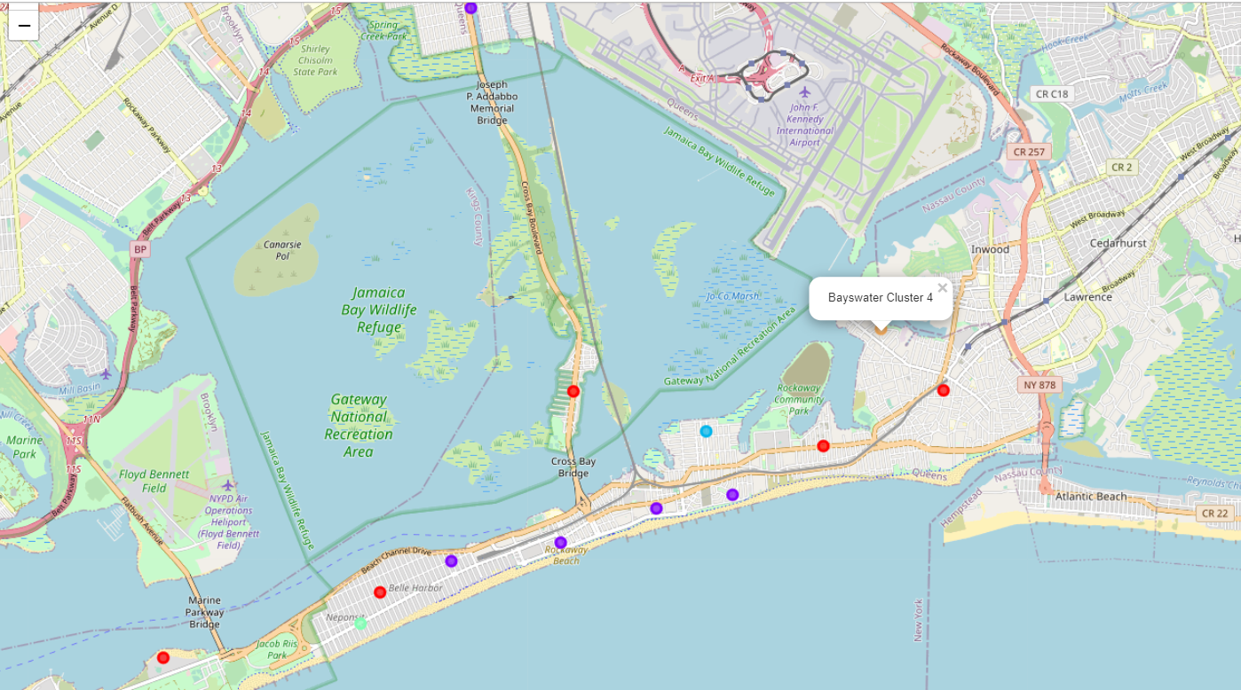
Option 2 Area

Slide 10
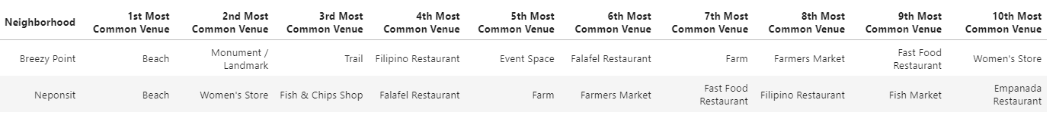
Option 3
Breezy Point and Neponsit neighborhoods are another cluster that has established restaurants and area attractions. It appears to be another possible location for a new vegetarian and vegan restaurant.

Slide 11
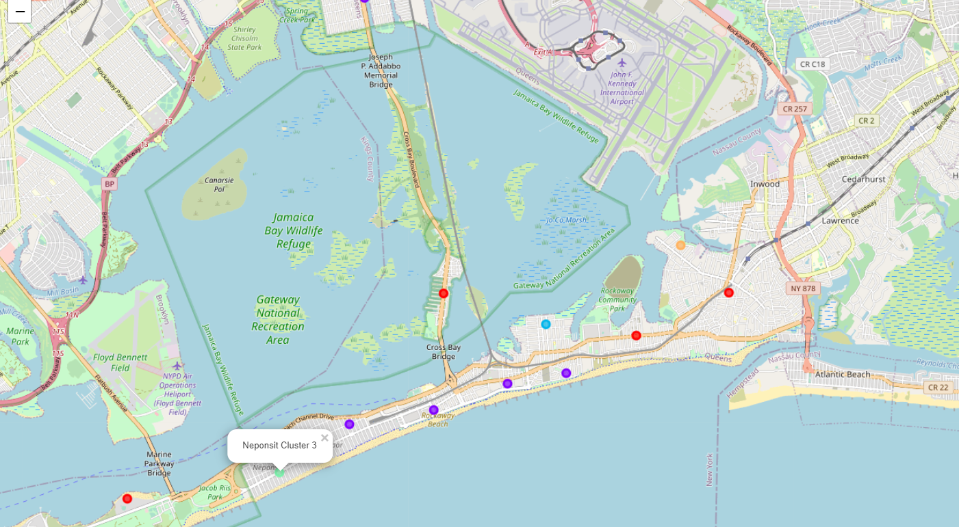
Option 3 Area

Slide 12
Why These Areas Were Chosen
Restaurants are already established in these neighborhoods so those seeking restaurants are already going to these neighborhoods
Neighborhood locations contain vegetarian and vegan restaurants as one of the most common neighborhood but very few options for diners
Area attractions such as event spaces, beaches, and tennis courts may be interested in a vegetarian and vegan restaurant option

Slide 13
Conclusion
There are very few options for vegetarian and vegan restaurants in Queens, New York though there are many multi-cultural restaurants. Adding a vegetarian and vegan restaurant to these suggested neighborhoods may be the best for your business.

